Slide 1
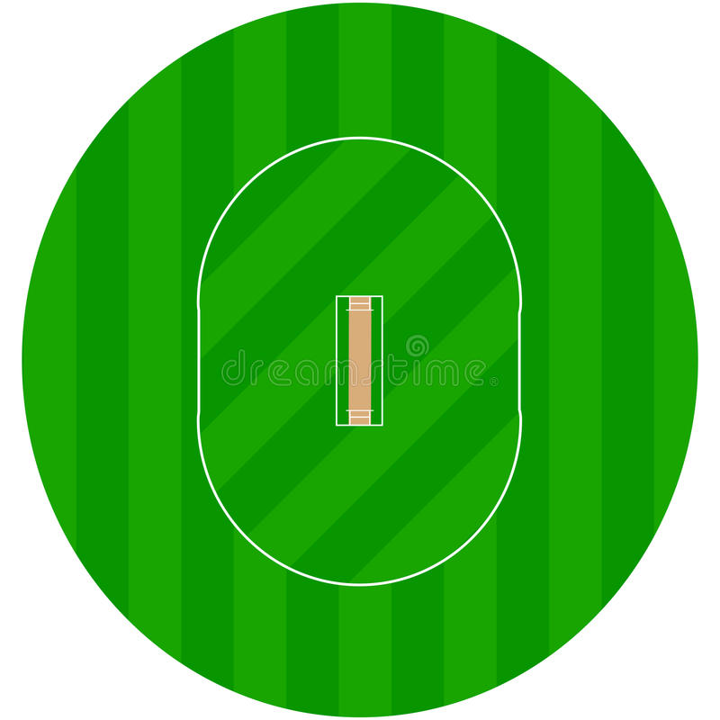

Hackathon 2019
Tech Fiesta 2019 Presents
Hari Kantipudi
Gayatri Kandula
Pallav Kumar
Kishan Sanghani
Nitin Rajora
Team – Data Geeks

Slide 2

Problem Statement
And the winner of Cricket World Cup 2019 is?
The most awaited season of Cricket is coming soon. Cricket World Cup 2019. Keeping in mind that there are sportsmen who are showing their best performances in the recent tournaments like IPL this has increased the expectations on the players as well as the Team. Considering all the points, predict the Winners of ICC Cricket World Cup 2019.
Following Information regarding the players and teams will be provided in the data-sets:
Player profile (like batting/bowling stats, team they belong to etc.)
Team match results for past 15 years

Slide 3


Explain your approach/business flow to the solution
Model Building
Data Prep
Prediction
EDA
Model Evaluation

Slide 4


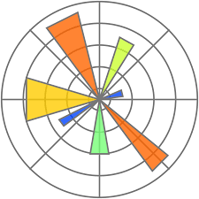






Technologies Used
Jupyter Notebook
Python
Microsoft Excel
Jupyter Lab
Machine Learning Algorithms
Random Forests
Anaconda Navigator
R esquisse

Slide 5
Solution
Preliminary Data Preparation and EDA
Steps in DP and EDA :
A . Data Cleansing
1. Null Value Checks
2. Data Type transformation – Object to Integer
3. Filtering Players playing current World Cup
4. Data Standardization – Player Names
5. Cleansing Junk and Special characters
B . Data Preparation
1. Denormalized data basis Player Name from Matches and Players
2. Deriving Feature Variables for each Team and Match
3. Drop variables not relevant to Model Building
4. Derived Target/Output variable

Slide 6
List of Features Derived
Mat_avg
Inns_Bat_avg
NO_avg
Runs_Bat_avg
Runs_Bat_avg.1
HS_avg
HS_max
Ave_Bat_avg
Ave_Bat_max
BF_avg
SR_Bat_avg
SR_Bat_max
X100_avg
X100_max
X50_avg
X50_max
X4s_avg
X4s_max
X6s_avg
X6s_max
Ct_avg
Ct_max
St_avg
St_max
Inns_Bowl_avg
Balls_avg
Runs_Bowl_avg
Wkts_avg
Wkts_max
Ave_Bowl_avg
Ave_Bowl_min
Econ_avg
Econ_min
SR_Bowl_avg
SR_Bowl_min
X4w_avg
X4w_max
X5w_avg
X5w_max
X10_avg
X10_max

Slide 7
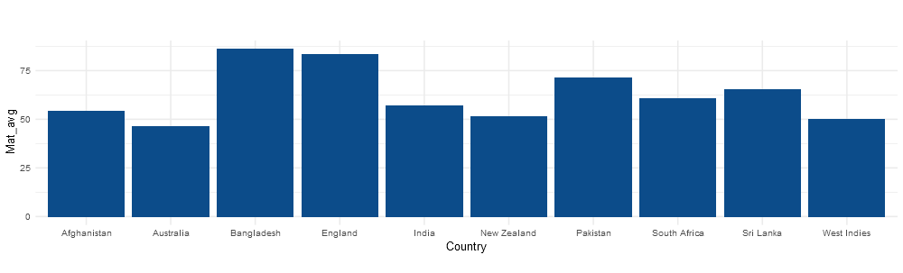
Exploratory Data Analytics
Basis derived features of recent – last 5 years ODIs by ten teams, Match Averages are depicted above

Slide 8
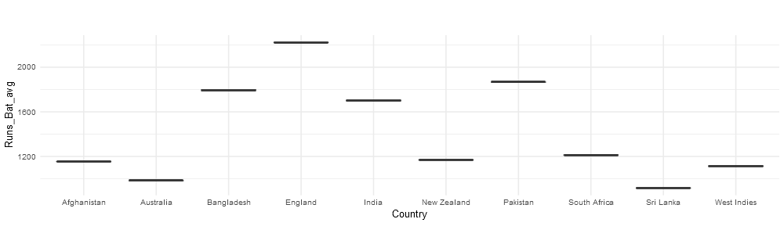
Exploratory Data Analytics
Basis derived features of recent – last 5 years ODIs by ten teams, Batting Averages are depicted above
Insights : England is best performer

Slide 9
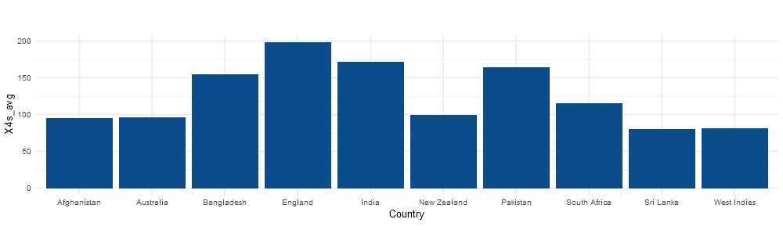
Exploratory Data Analytics
Basis derived features of recent – last 5 years ODIs by ten teams, Max Boundaries (4s) are depicted above
Insight : England is the best performer

Slide 10
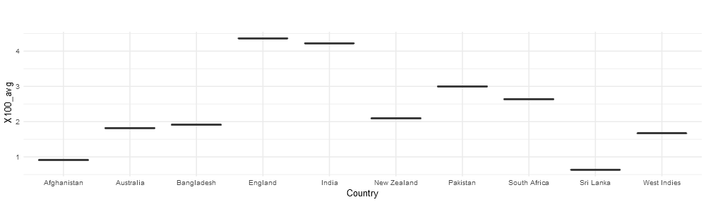
Exploratory Data Analytics
Basis derived features of recent – last 5 years ODIs by ten teams, Max Centuries are depicted above
Insight : England and India are the best performers

Slide 11
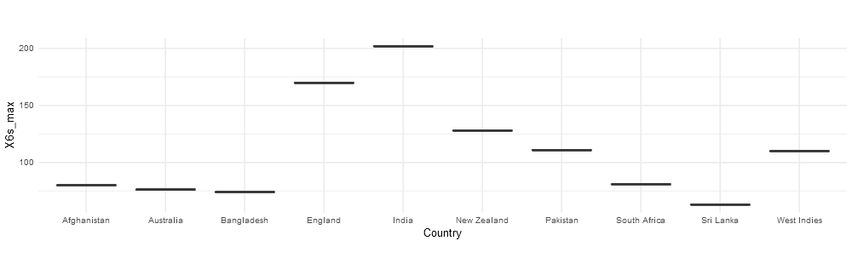
Exploratory Data Analytics
Basis derived features of recent – last 5 years ODIs by ten teams, Max 6s are depicted above
Insight : England and India are the best performers

Slide 12
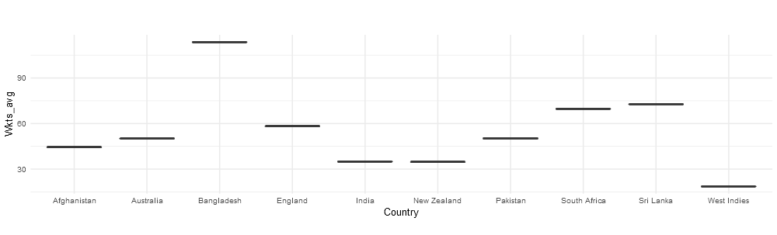
Exploratory Data Analytics
Basis derived features of recent – last 5 years ODIs by ten teams, Wickets Average are depicted above
Insight : Bangladesh is the least performer

Slide 13
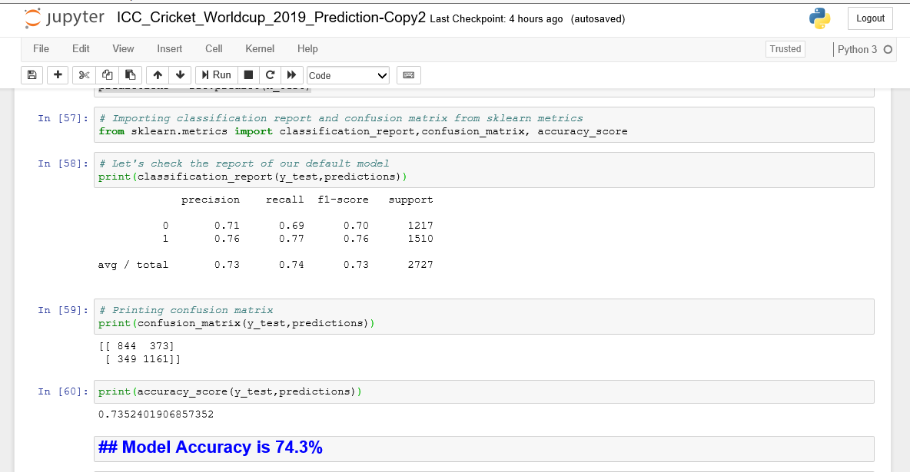
Solution
Random Forests and Prediction Insights
Random Forests Algorithm
Using Random Forests , an algorithm is trained basis all derived features
Prediction Accuracy is ~74%

Slide 14
Prediction - Final
Winner is England
Considering insights above
Simulating Matches with each of the country
Considering 5 years ODI data
England and India are most probable achievers

Slide 15










Q & A

